Slide 1
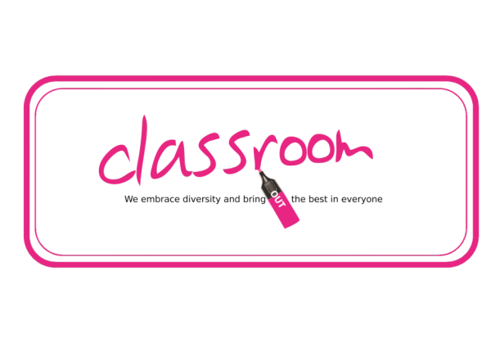
PSHE
I’ve Always Wanted to Know…

Slide 2
At the End of this Lesson
You Should Know:
That there are many different terms used to describe sexual orientation and gender identity;
That these terms change over time;
That some terms can be offensive;
That some terms are inclusive and some are exclusive;
That some are used wrongly every day.

Slide 3
Glossary
Sexual orientation means who you find emotionally and/or sexually attractive
A lesbian or a gay woman’s sexual orientation is towards other women
A gay man’s sexual orientation is towards other men
A bisexual person’s sexual orientation is towards both men and women
Sexual orientation has nothing to do with gender identity.

Slide 4
Inclusive and Exclusive
What is the difference between an inclusive lesson and an exclusive lesson?

Slide 5
Inclusive and Exclusive
An exclusive lesson would exclude some people; or leave them out. Maybe the material was too hard or too easy for some; maybe some have done it before. Perhaps people were expected to read small text from the interactive whiteboard and some in the class are visually impaired. An inclusive lesson includes or involves everyone, so the whole class leaves knowing that they’ve learned something.

Slide 6
LGBT+
In our last lesson we learned that LGBT+ is a better term that LGBT because the ‘+’ represents people who are not cisgender or heterosexual but are not lesbian, gay, bisexual or trans; such as intersex, non-binary or asexual people for example. Without the ‘+’, they would be excluded.
Therefore we can say that LGBT+ is a better term than LGBT because it is more exclusive.

Slide 7
I’ve always wanted to know…
Discuss these questions.
Can we not just say ‘Gay’ instead of LGBT+?
Can I call my LGBT+ friend ‘Queer’?
What does ‘pathologise’ mean?
Can I call someone ‘homosexual’?
Can I call someone ‘transsexual’?
A transgender person must be gay, lesbian or bisexual at some point on their journey, mustn’t they?
Is your sexual orientation fixed? Or can it change?

Slide 8
I’ve always wanted to Know…
Can we not just say ‘Gay’ instead of LGBT+?
No. Some lesbians do not identify as ‘gay’; bisexuals are by definition bisexual as opposed to ‘gay’; and gender identity has nothing to do with sexual orientation.
So gay is an exclusive term.

Slide 9
I’ve always wanted to Know…
Can I call my LGBT+ friend Queer?
Not without their permission. ‘Queer’ was used in the past as an abusive term. The LGBT+ community have reclaimed it and a lot of people now use it as a challenge.
But it’s up to your friend to decide whether they want to self-identify as ‘queer’. Try asking them.
The same applies to the term ‘dyke’ when referring to a lesbian. Many lesbians have reclaimed the term ‘dyke’ and use to describe themselves, but very few if any would like to be called a ‘dyke’ by a complete stranger! And some would never use the term at all.
Misuse of either of these two words could be construed as a hate crime so avoid them if there is any doubt.

Slide 10
I’ve always wanted to Know…
What does ‘pathologise’ mean?
To pathologise something means to turn it into an illness. Homosexuality, or same-sex-desire, was considered a mental illness from Victorian times until the late 20th century. Gender variance was considered to be a mental disorder until very recently. Now they are both considered to be a part of nature.

Slide 11
I’ve always wanted to Know…
Can I call someone homosexual?
Can I call someone transsexual?
No. They are both offensive because they carry a lot of history. The word homosexual pathologises same-sex desire. Transsexual used to be a legal term describing someone who was to undergo, or was undergoing, or had undergone gender reassignment surgery. But when you lump it together with bisexual it sounds as if someone is changing their sexuality rather than their gender!

Slide 12
I’ve always wanted to Know…
A transgender person must be gay, lesbian or bisexual at some point on their ‘journey’, mustn’t they?
Not necessarily. Remember gender identity has nothing to do with sexual orientation. It pays never to make assumptions.

Slide 13
I’ve Always wanted to know…
Is your sexual orientation fixed? Or can it change?
It can change – although this is uncommon. Tom Robinson was a famous gay musician in the late 70s and early 80s and he fell in love with and married a woman. Some people claim that their sexual orientation has changed, usually towards same-sex desire as they have grown older. This is known as gender fluidity. But you cannot choose your sexual orientation. It chooses you.

Slide 14
Plenary
Write down for homework:
What LGBT+ means and why we use it;
The difference between gender and sex;
Three other things you learned

